Slide 1
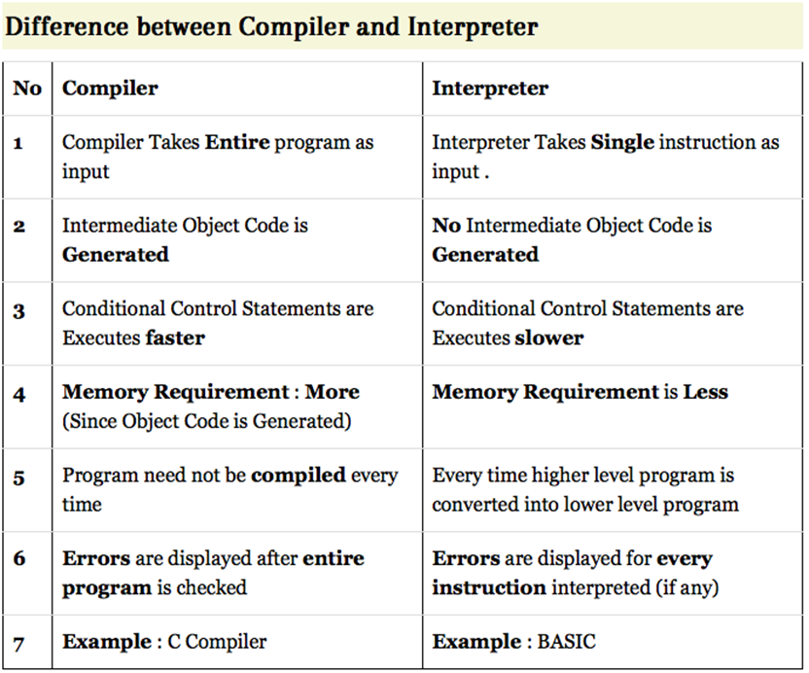

Slide 2
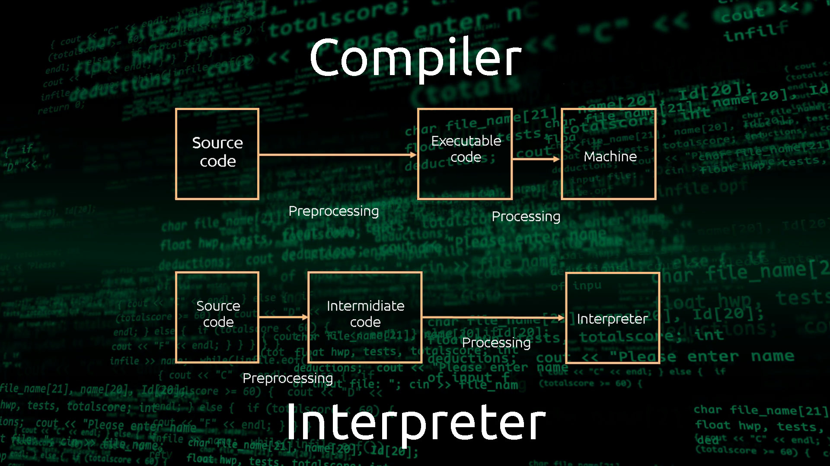

Slide 3
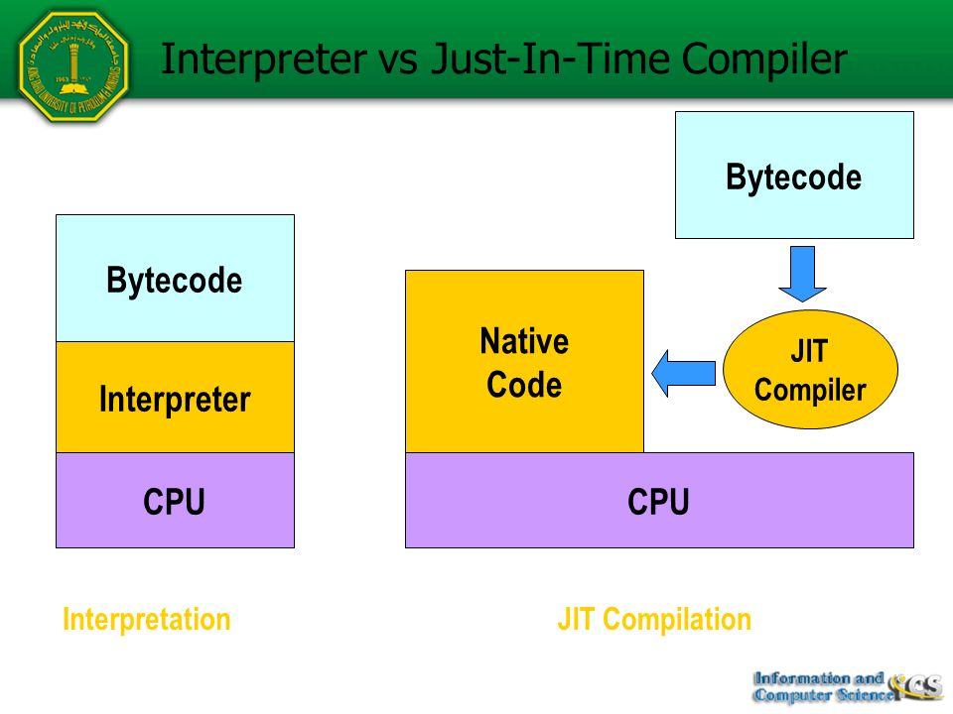

Slide 4
C compile
IDE(Visual Studio)

Slide 5
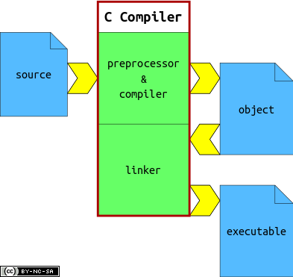

Slide 6
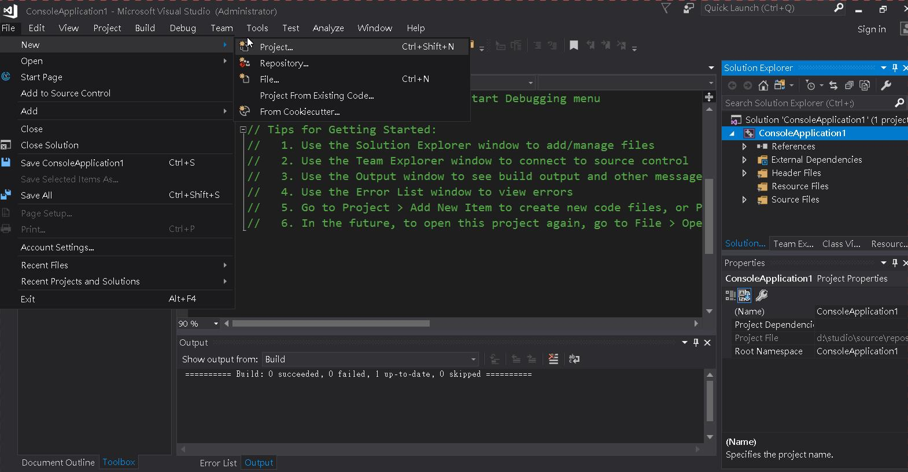

Slide 7
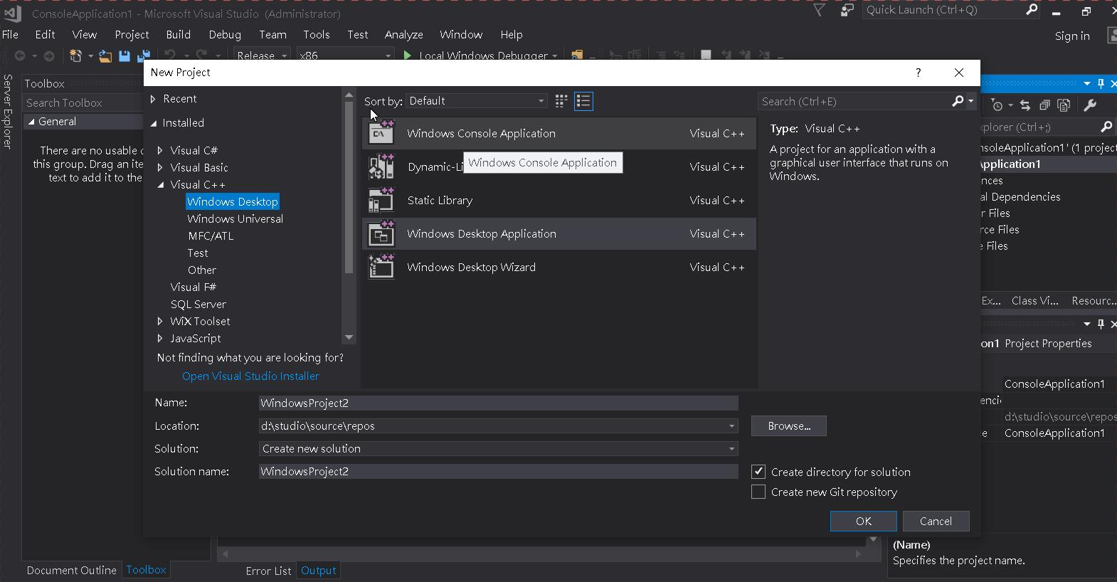

Slide 8
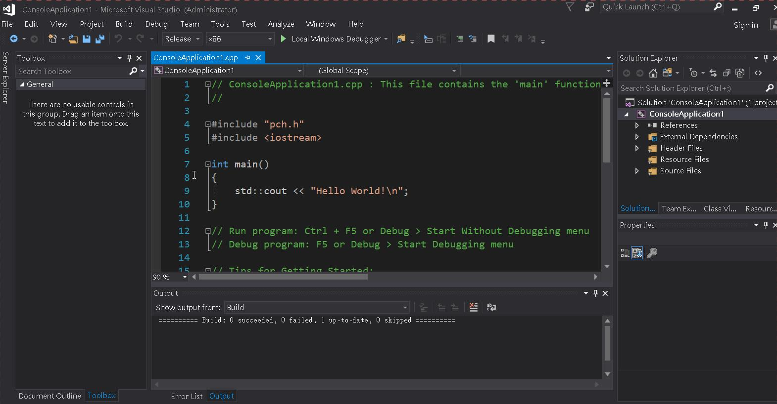

Slide 9
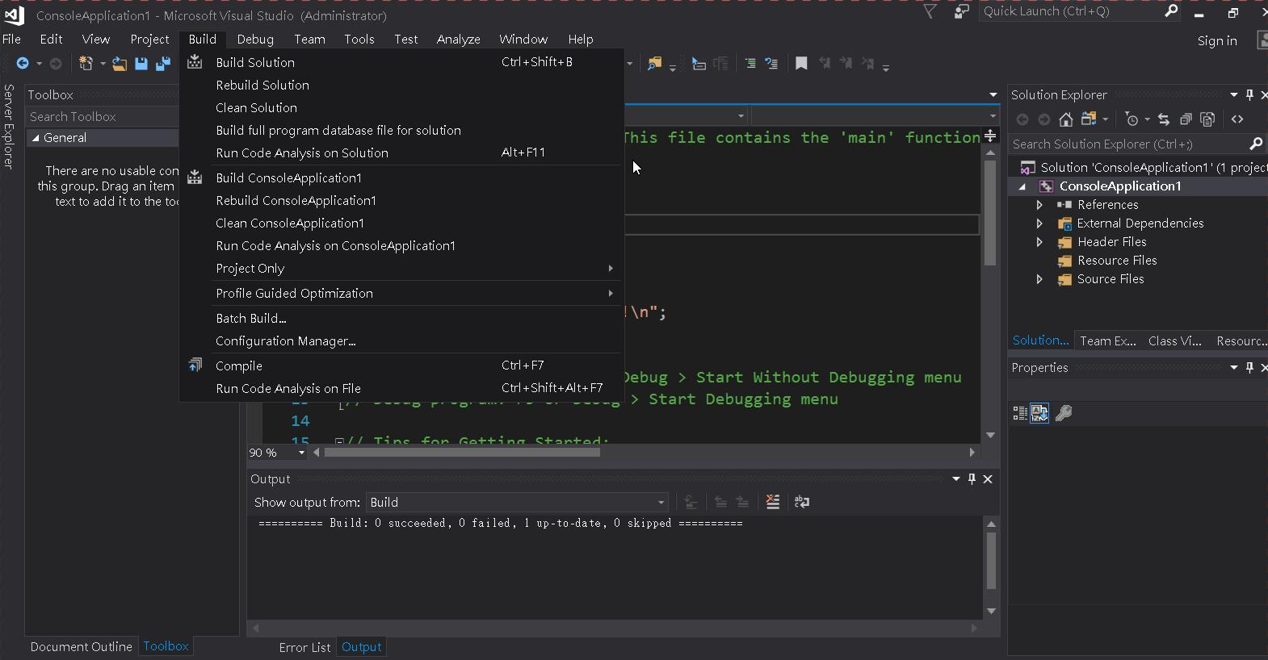

Slide 10
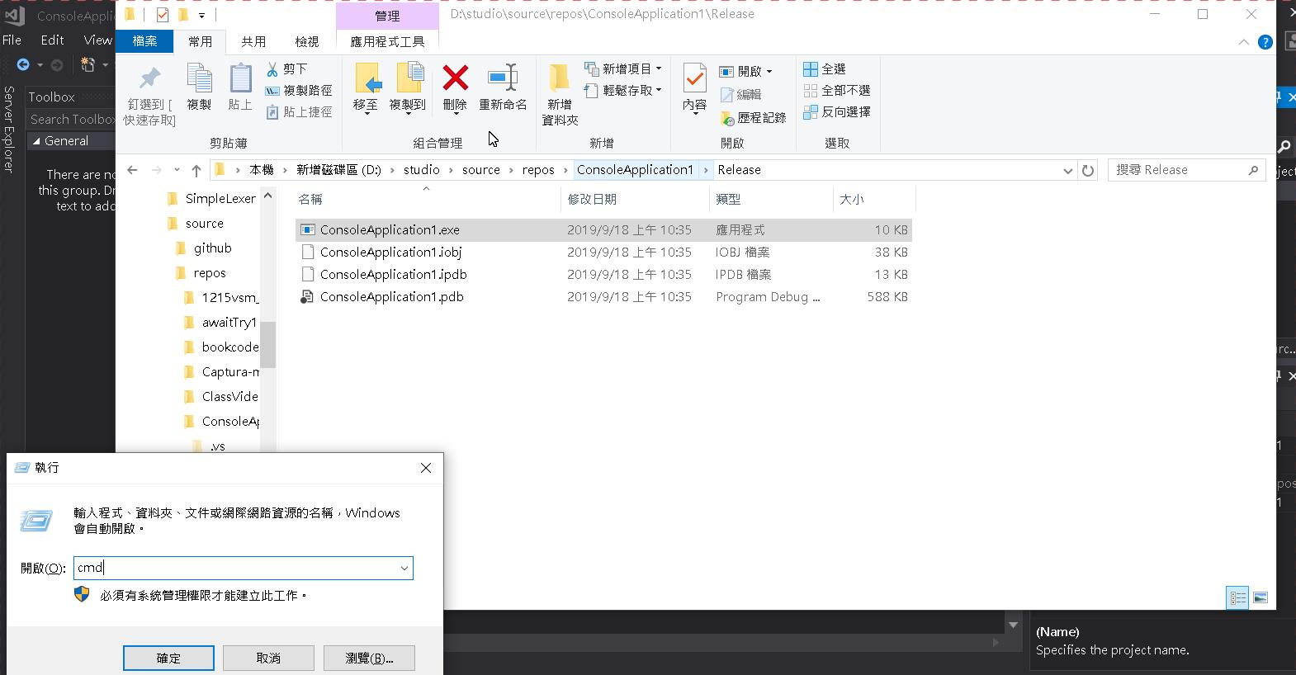

Slide 11
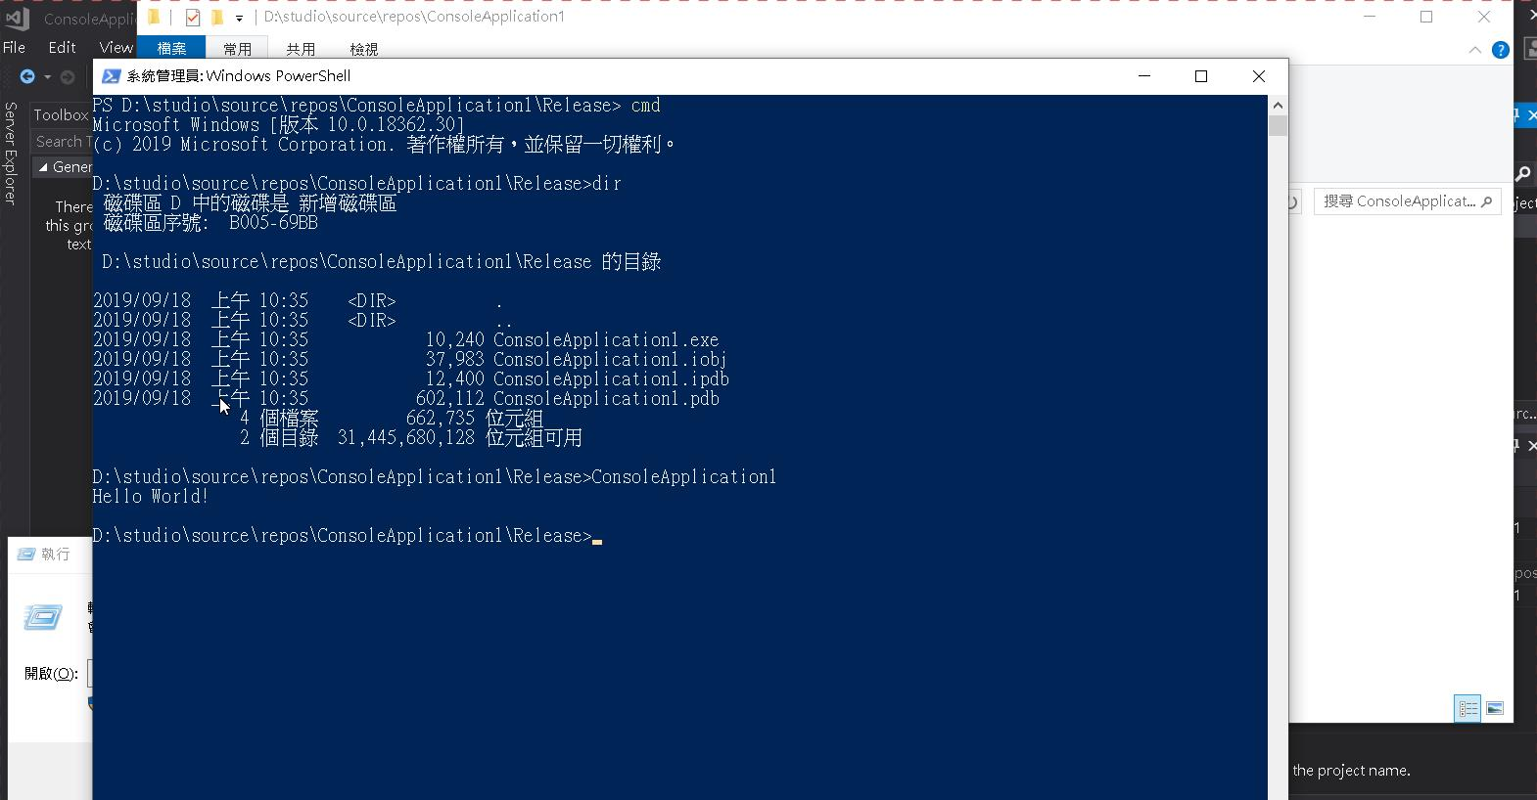

Slide 12
C Compile
linux GCC command line

Slide 13
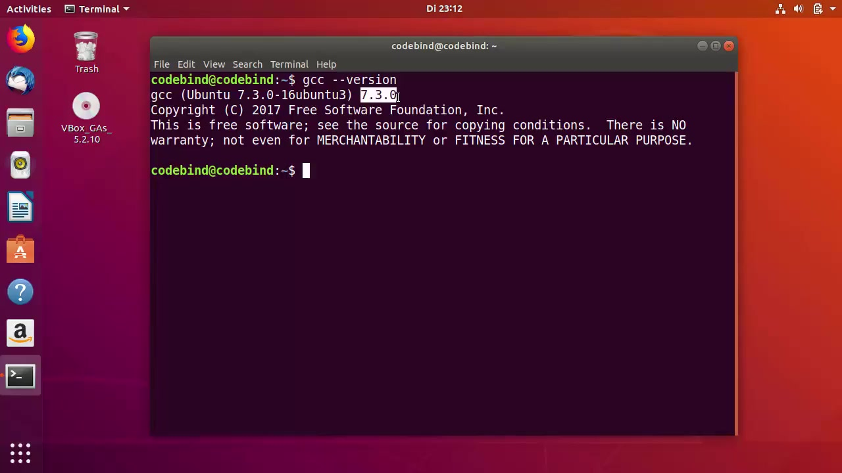

Slide 14
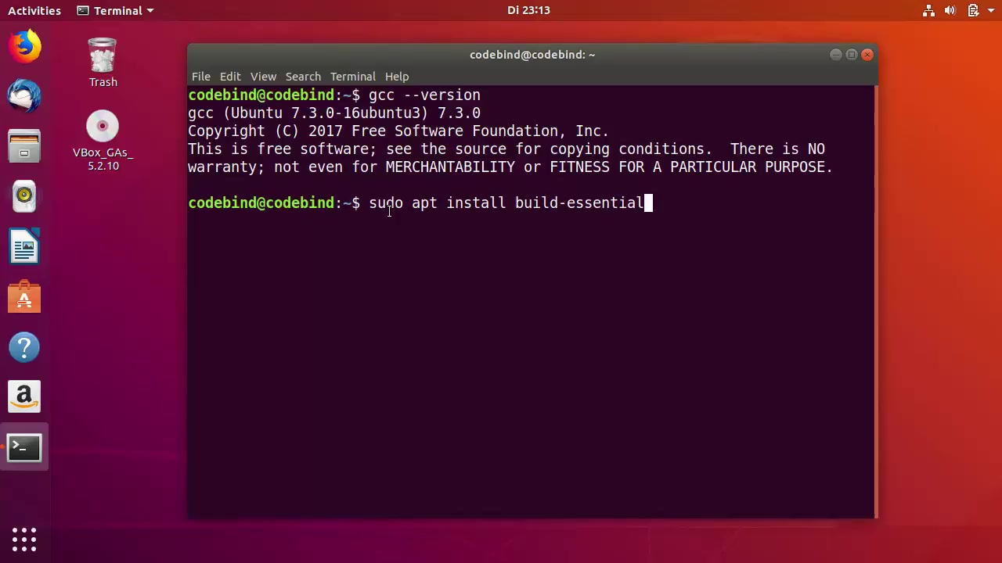

Slide 15
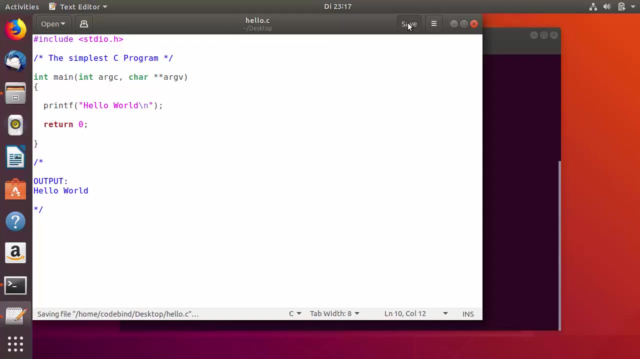

Slide 16
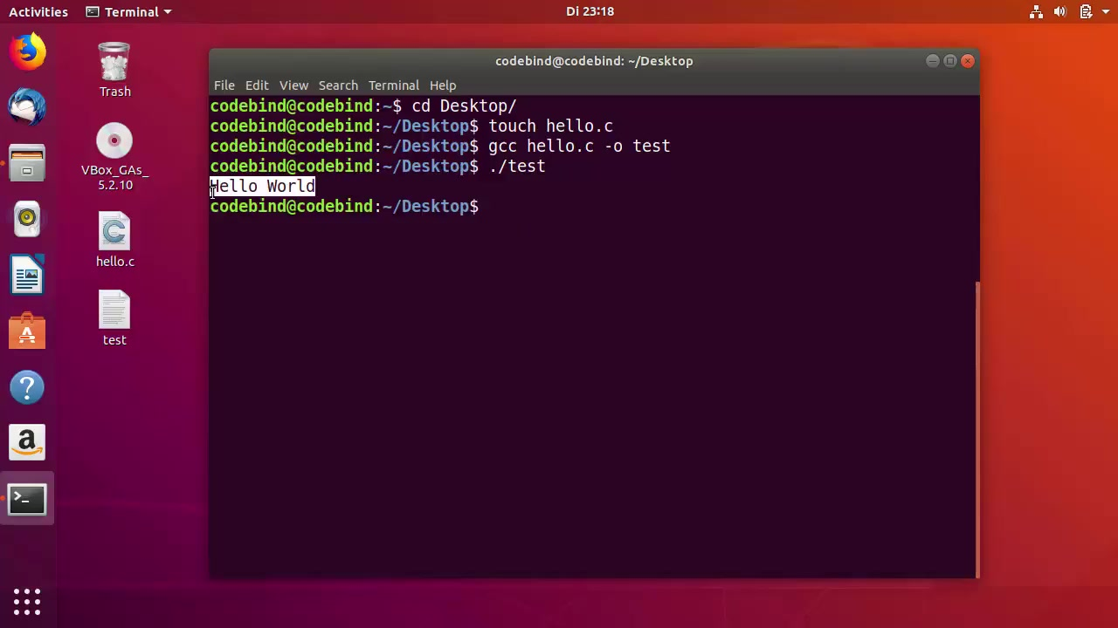

Slide 17
java

Slide 18
https://www.compilejava.net
public class HelloWorld
{
public static void main(String []args)
{
System.out.println("Hello World");
}
}

Slide 19
一般系統上已經有java run time
但是要編譯java code, 需要java sdk 中的javac
javac hello.java -->hello.class
java hello, or hello.class
java -jar hello.jar

Slide 20
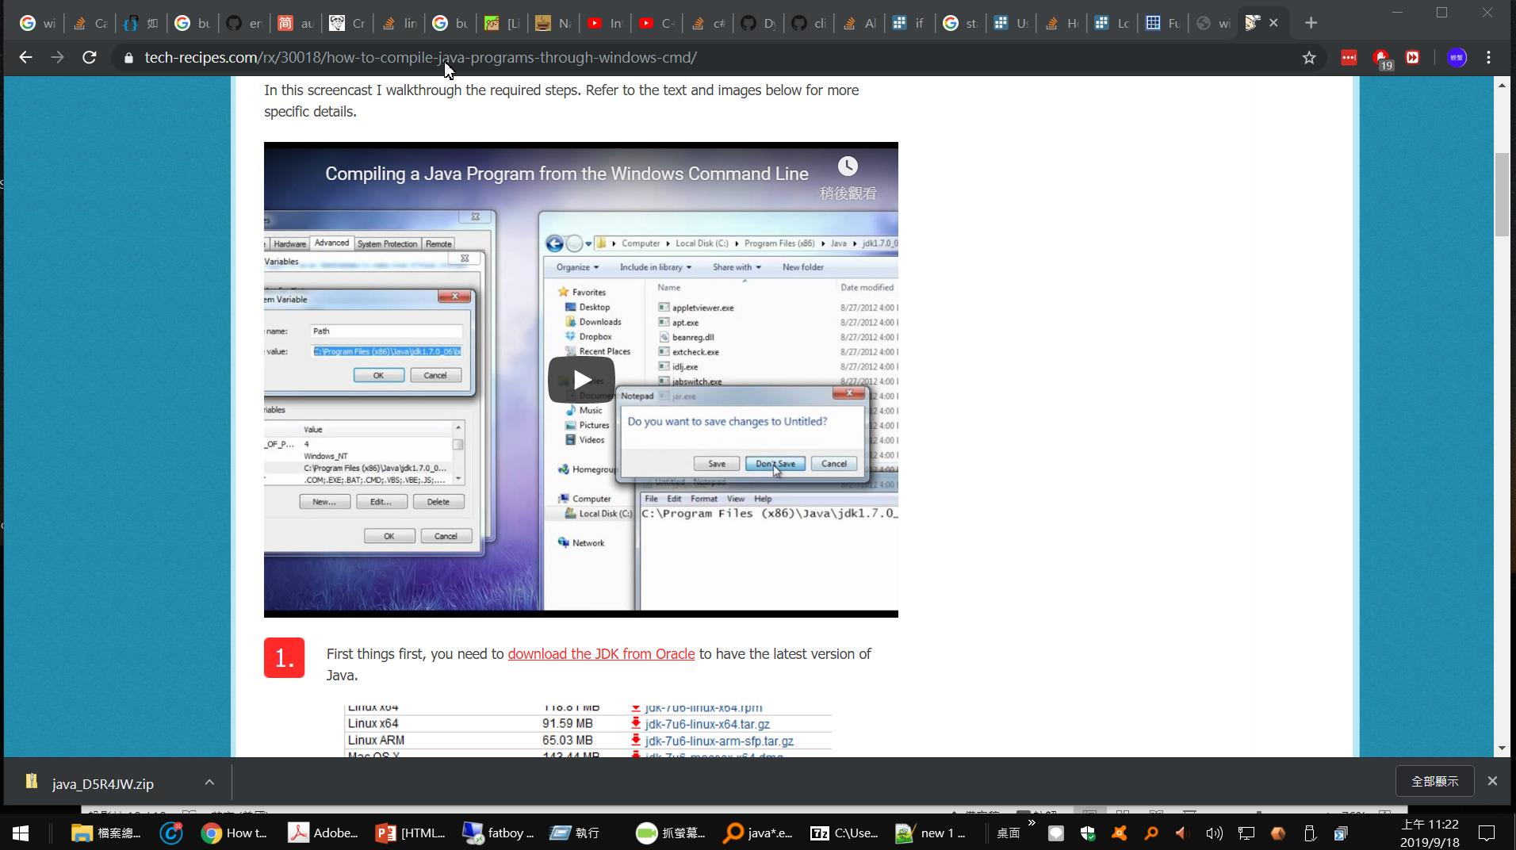
https://www.tech-recipes.com/rx/30018/how-to-compile-java-programs-through-windows-cmd/

Slide 21
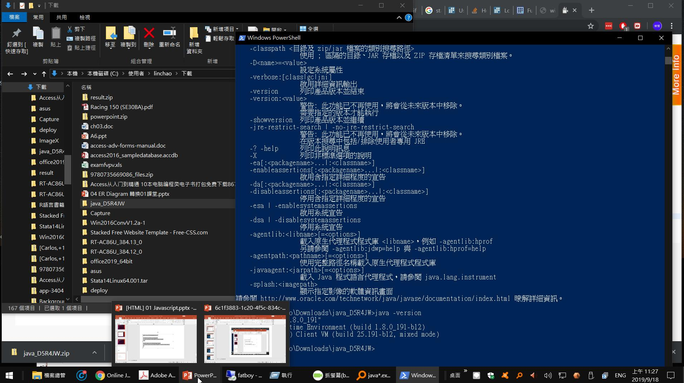
java

Slide 22
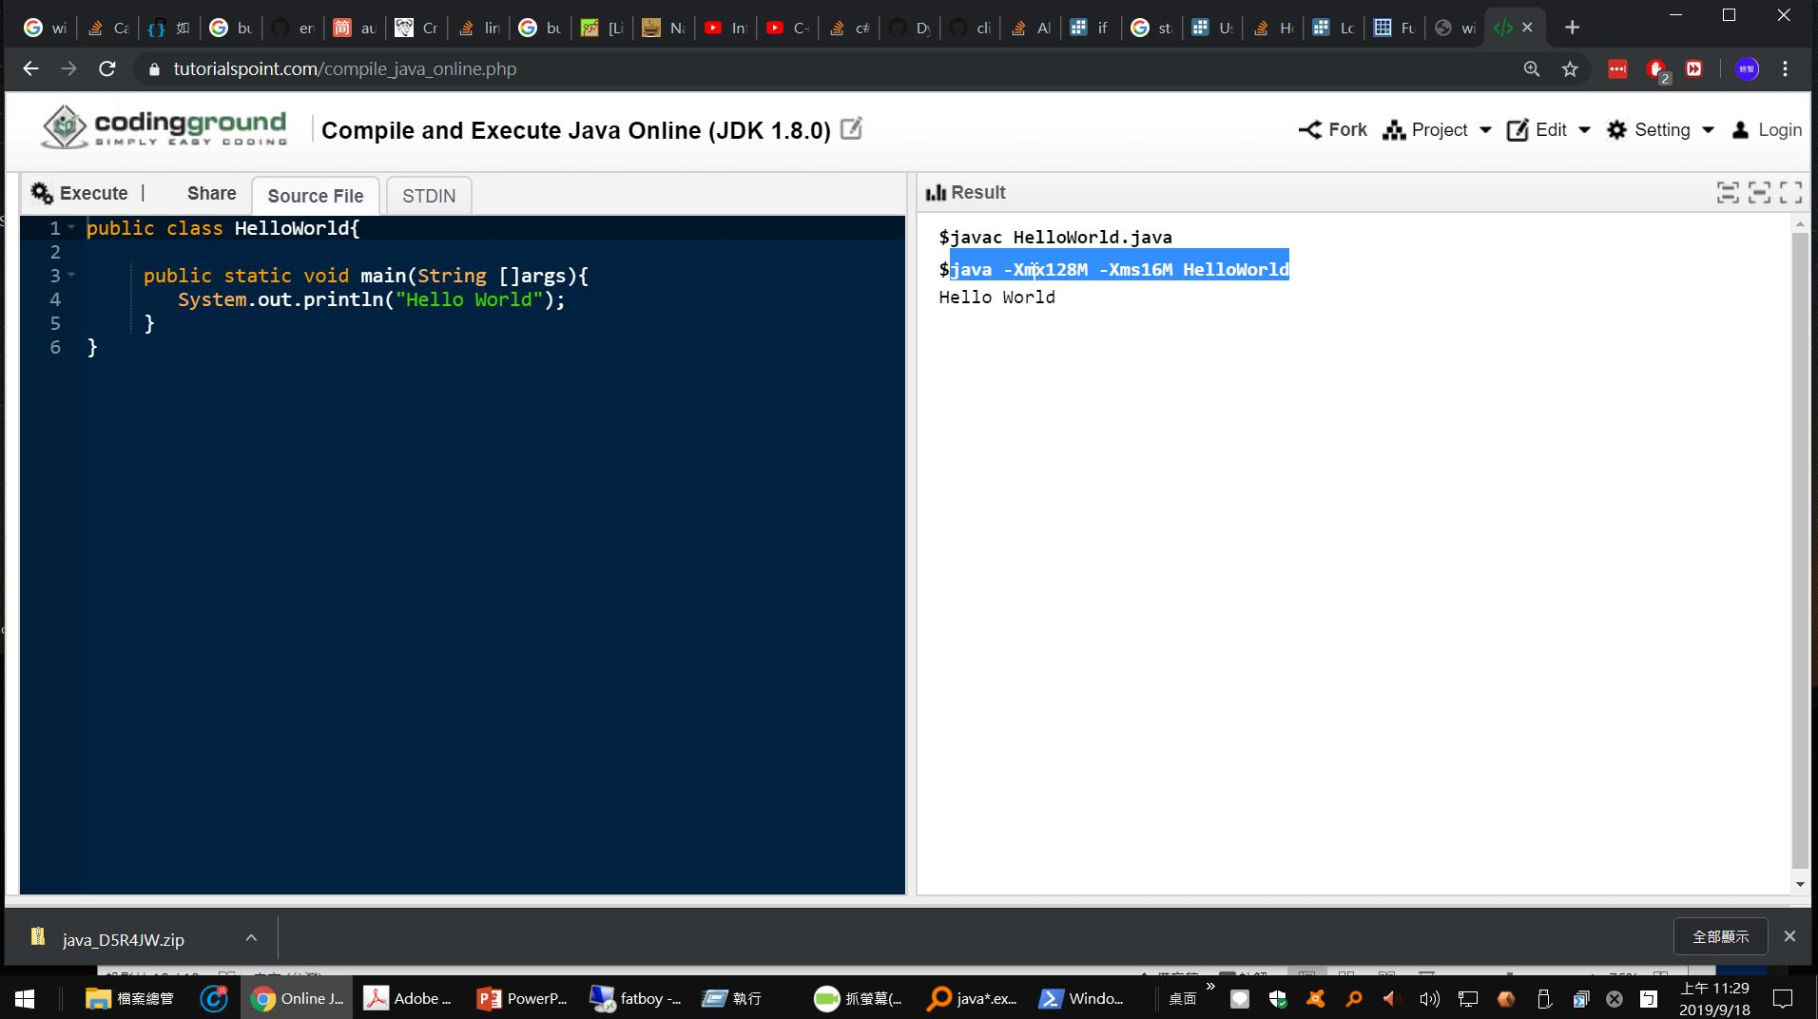
https://www.tutorialspoint.com/compile_java_online.php

Slide 23
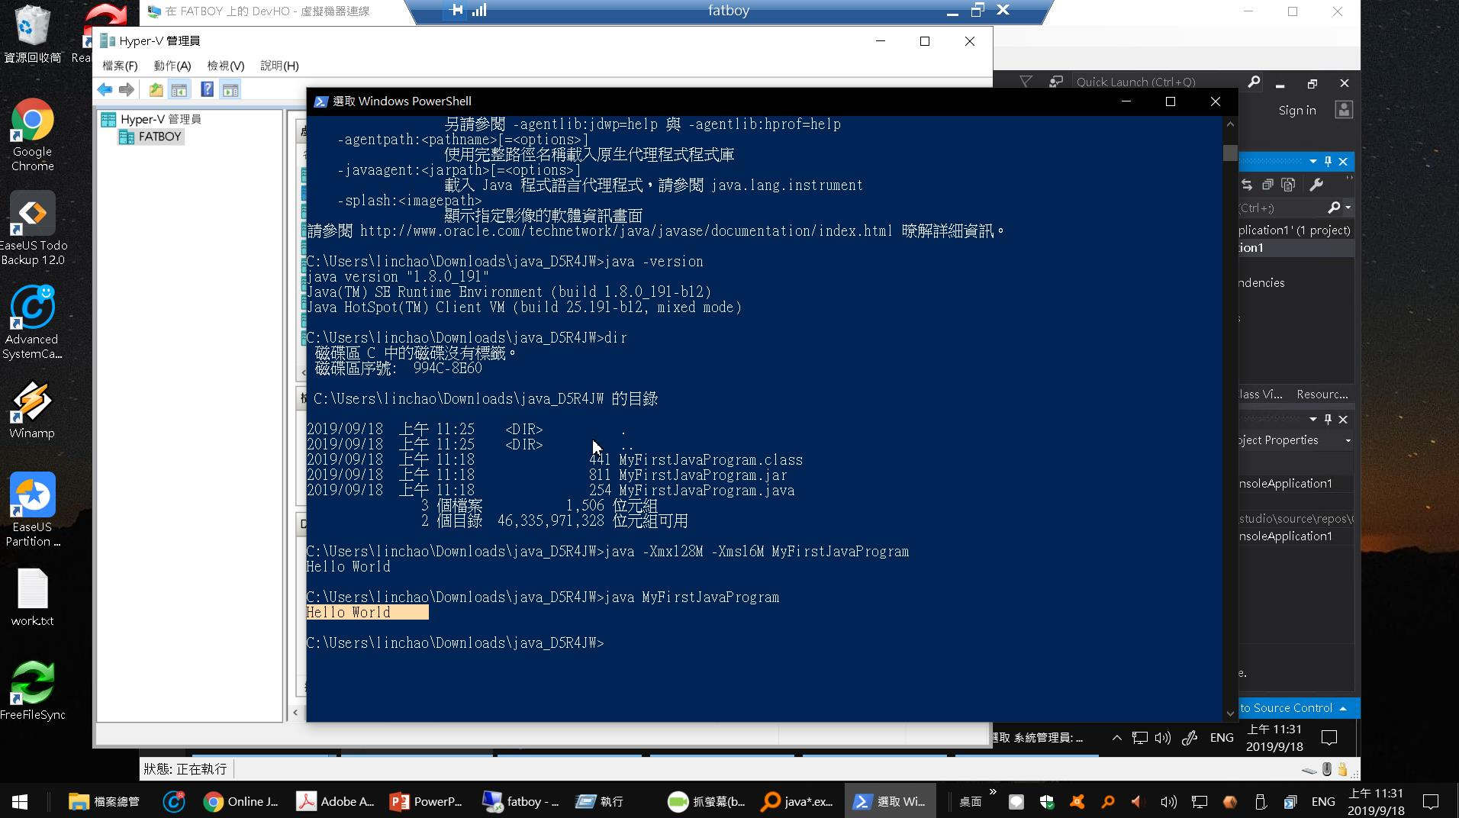

Slide 24
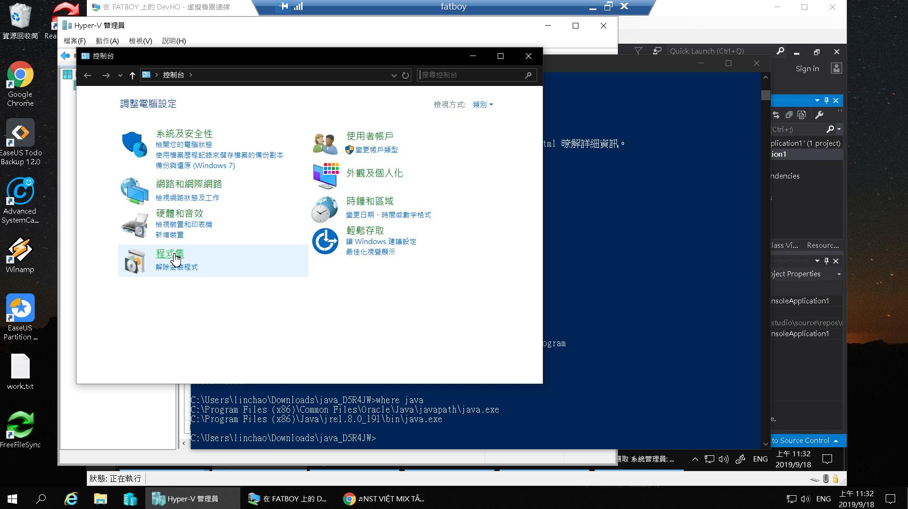

Slide 25
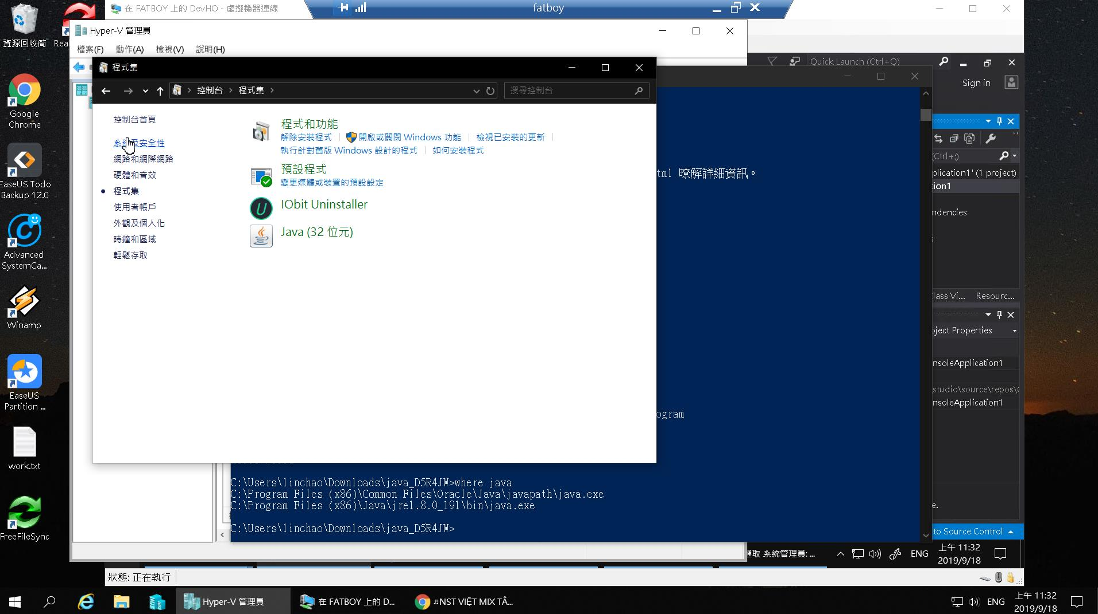

Slide 26
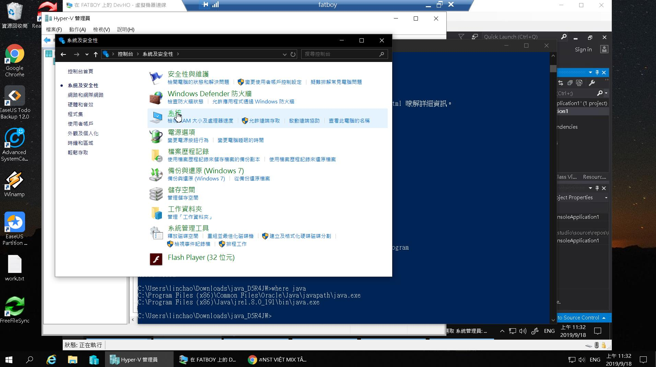

Slide 27
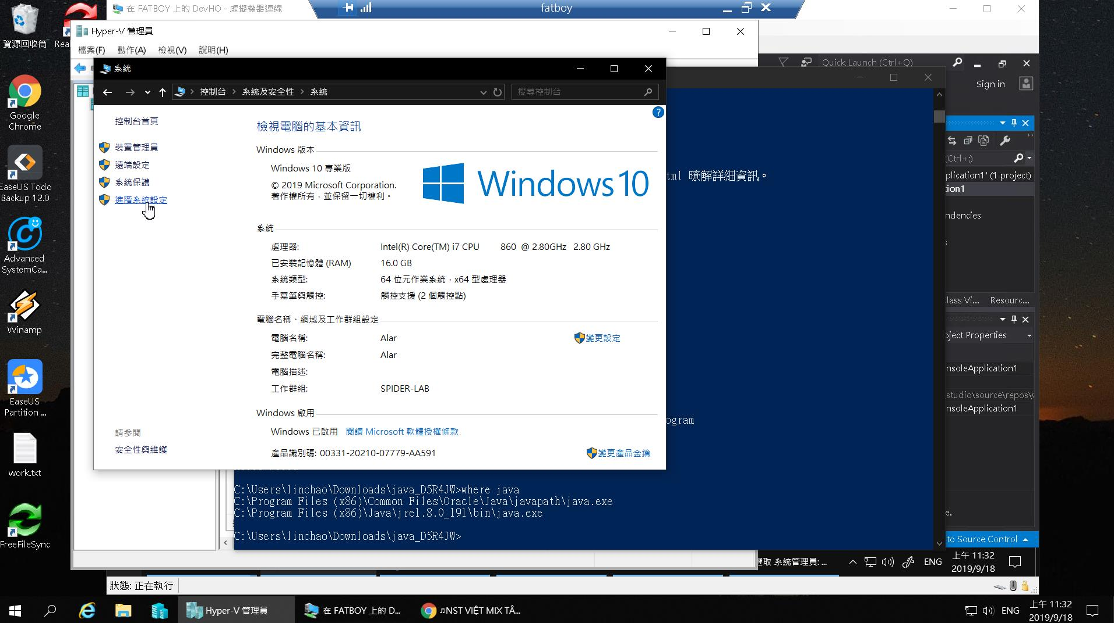

Slide 28
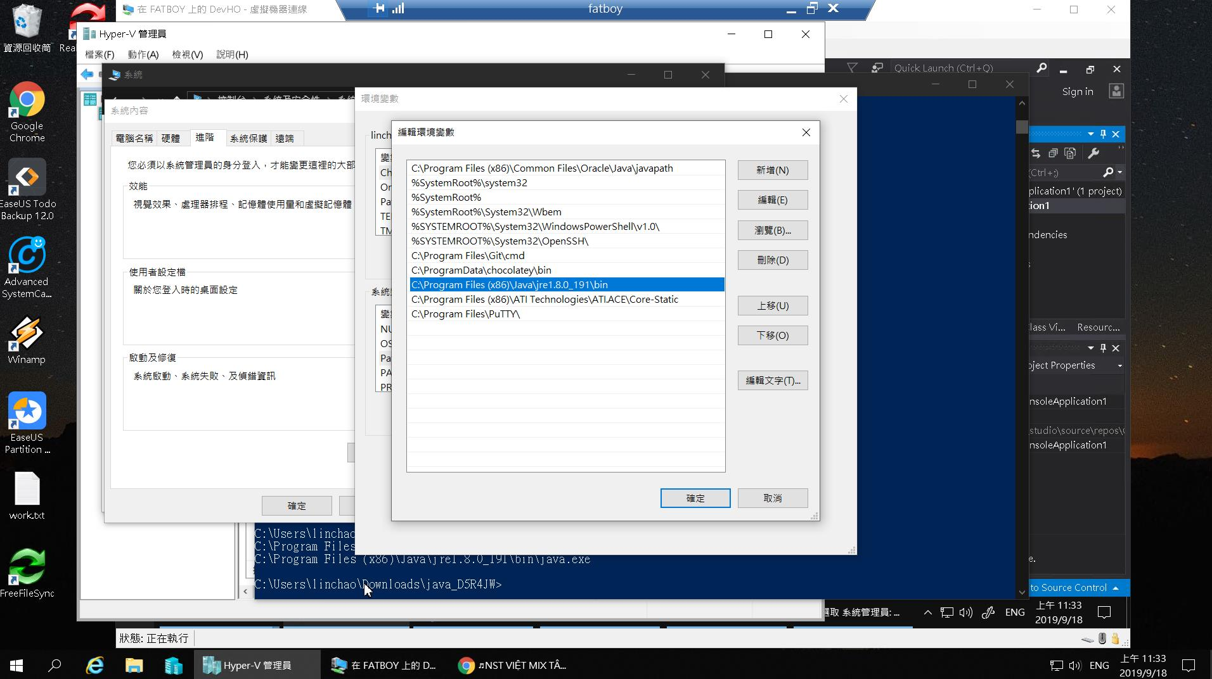

Slide 29
